Slide 1
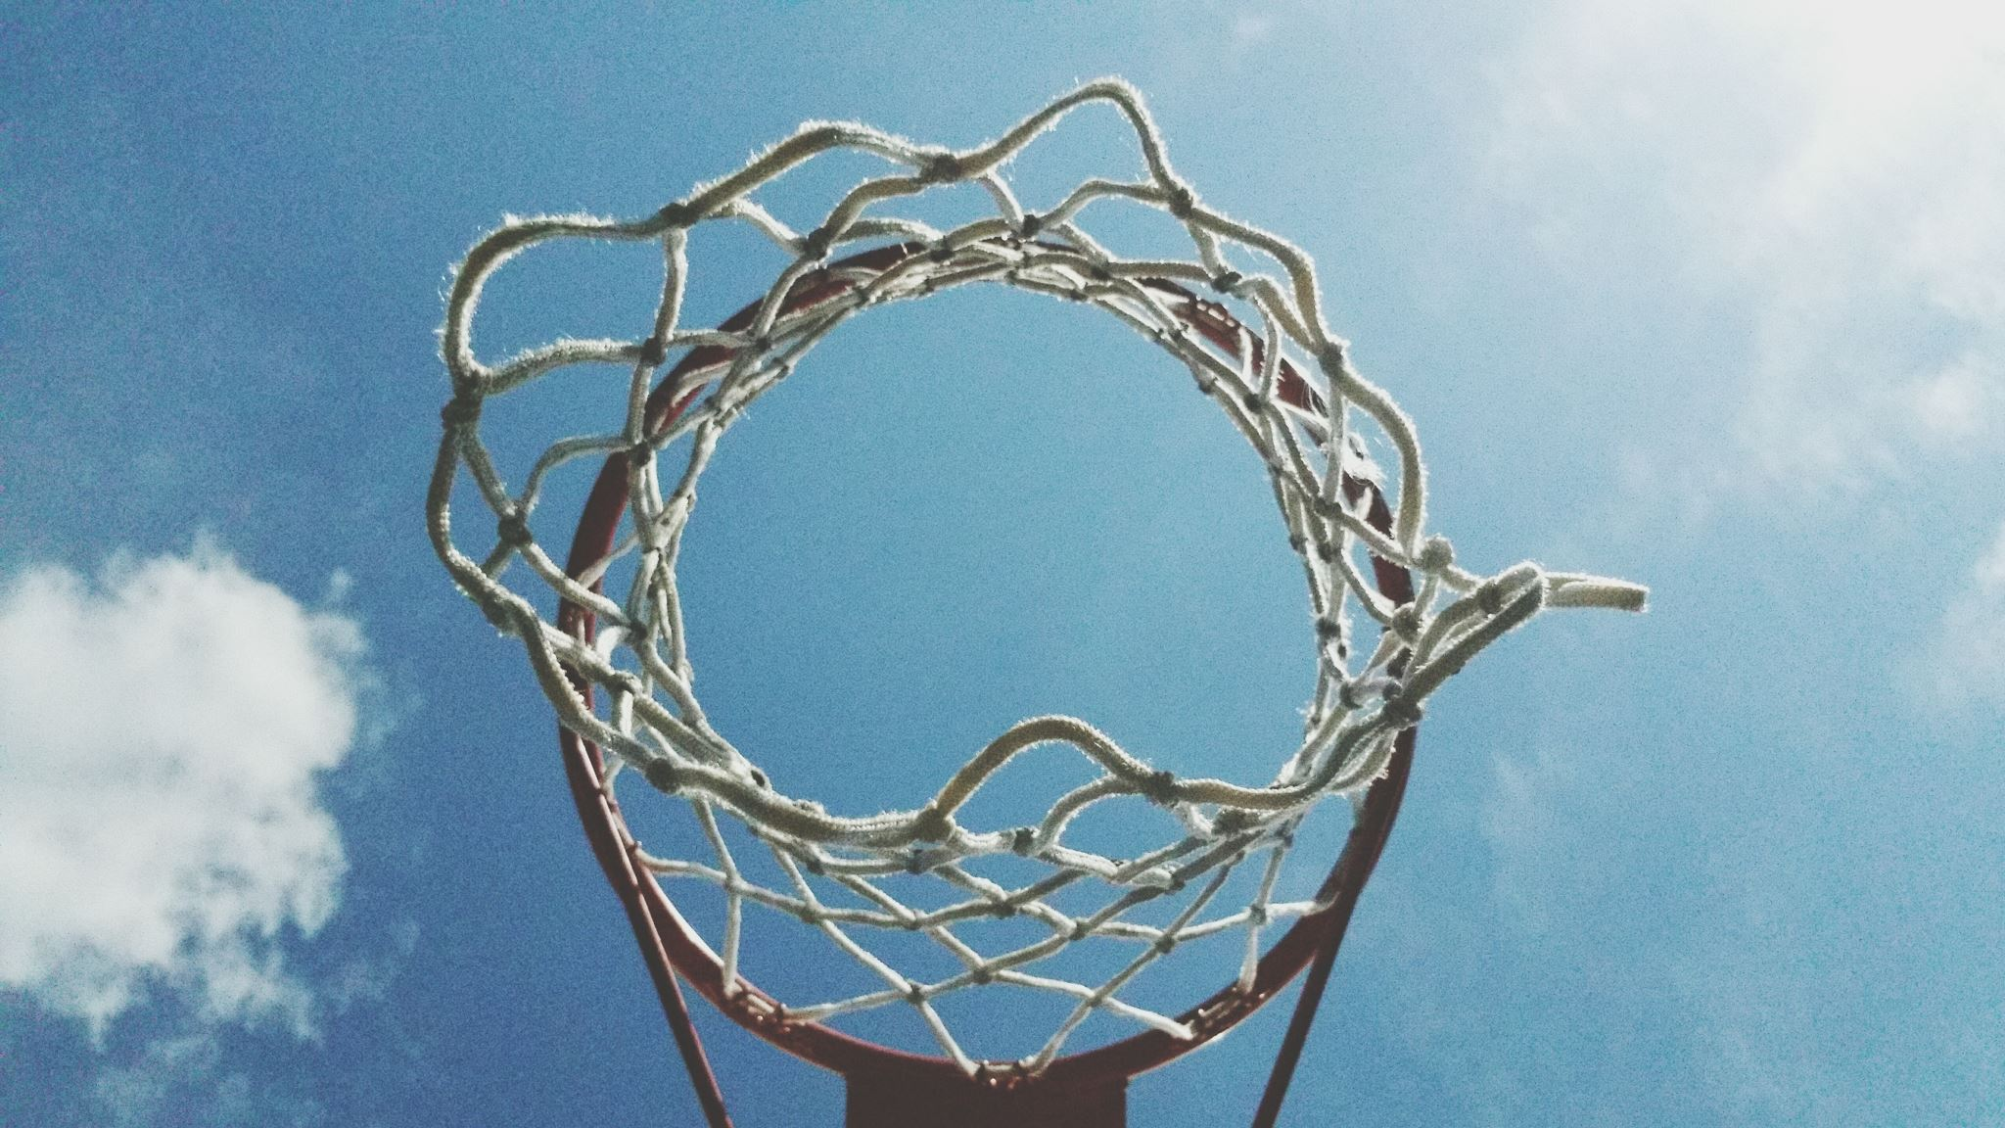
Object Tracking in the NBA
Automating Statistical Recording Basketball

Slide 2

Motivation
Find Inexpensive, Basic way to track basketball analytics and create highlight reels for immediate consumption.

Slide 3
Use Cases
Television Networks – Quickly Uploading Game Highlights to Social Media
Basketball Teams – Automatically record game statistics to use for game planning (used to track player movement and distance travelled)
Individual Development – High School players can analyze their own game film

Slide 4
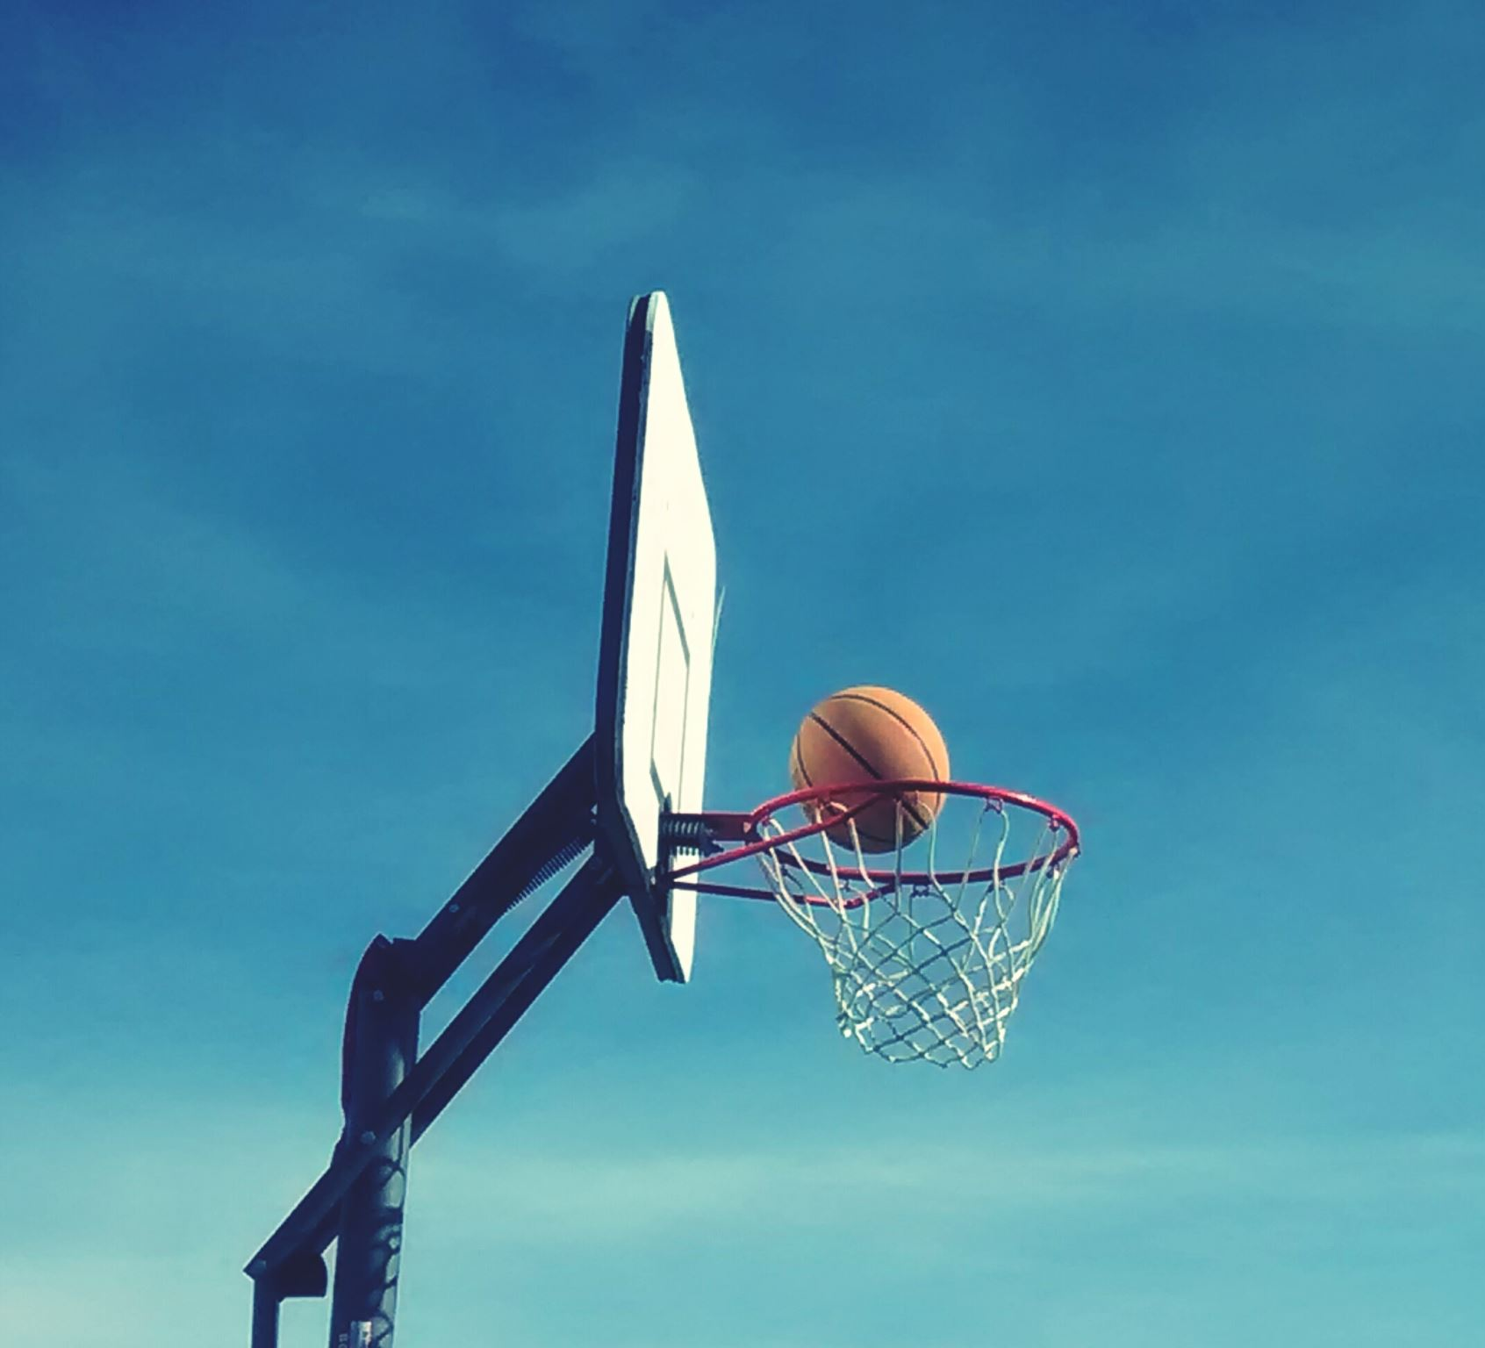
How to Identify a Basketball or a made basket?

Slide 5
Neural Networks
Trained a YOLO Model on 1500 images of Basketballs and “Made Baskets”

Slide 6
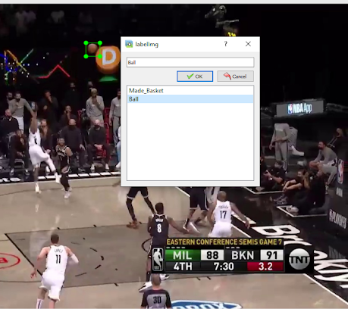
The Data
Screen Recorded 4 Basketball Broadcasts from Youtube
Used cv2 to turn these videos to images
Labeled the basketball and “made baskets” on 1500 images.

Slide 7

Pre-processing
Removed non-relevant images from the dataset
Did this as I labeled the images

Slide 8
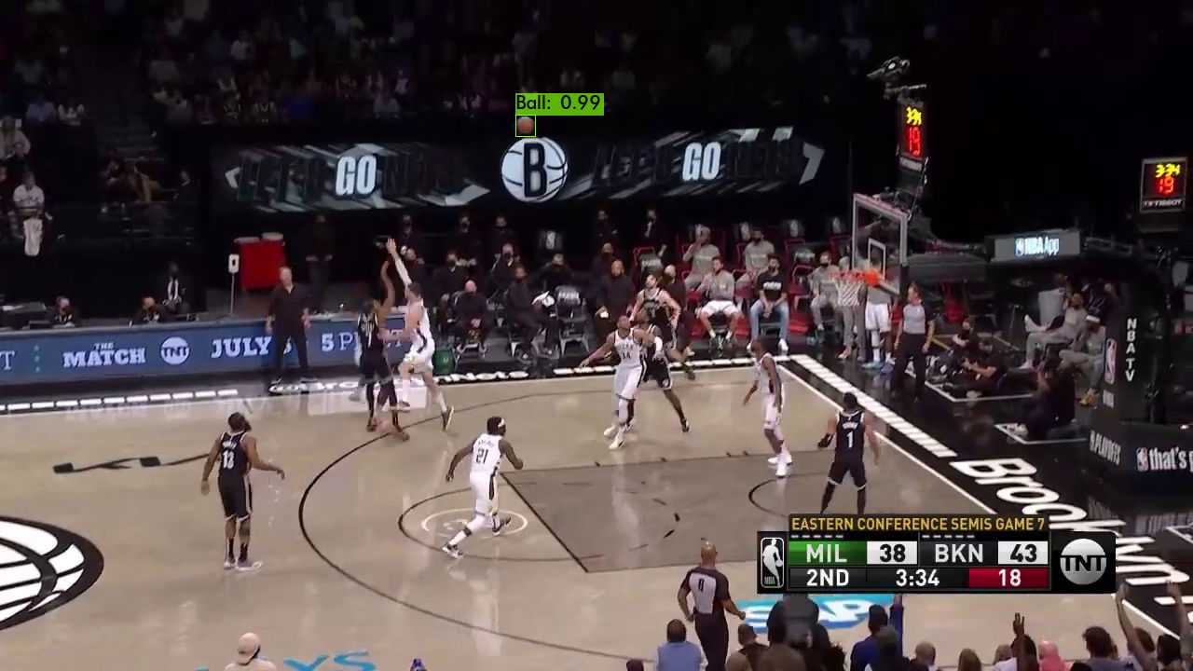
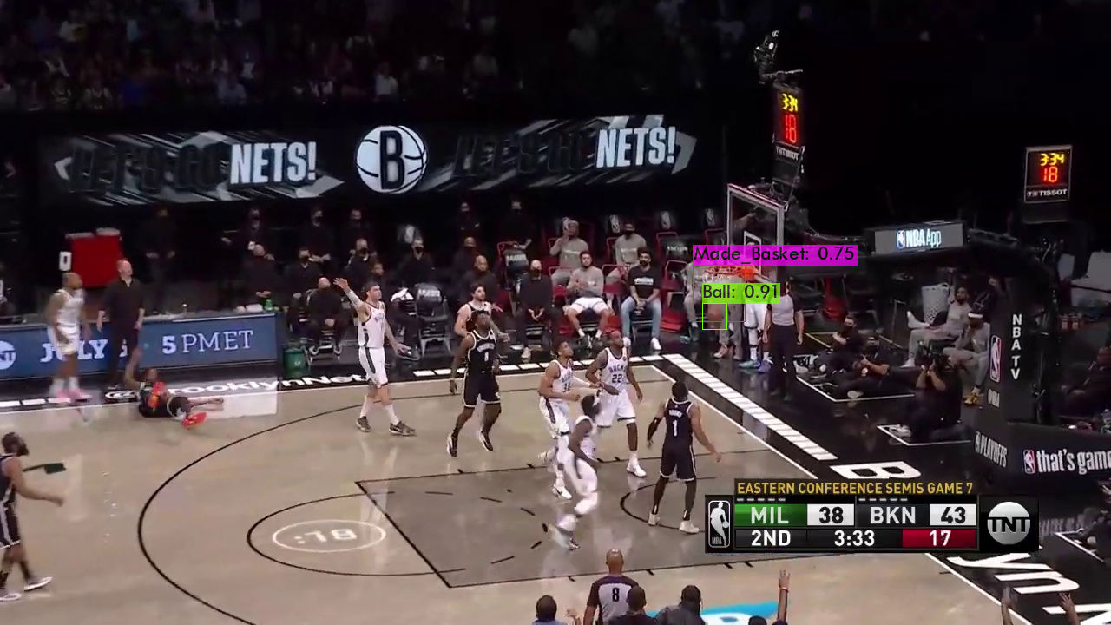
Model Training
Trained model using free GPU on Google Colab
Used Pretrained YOLO weights as a kicking off point
Training took about ≈ 12 hours
Basketball Detection
Made Basket Detection

Slide 9
Player Tracking
Used pre-trained weights for player detection.
Used Deep Soot framework for player tracking rather than detection.
With detection each frame is independent
Tracking creates objects from detections
Connected detections across frames

Slide 10
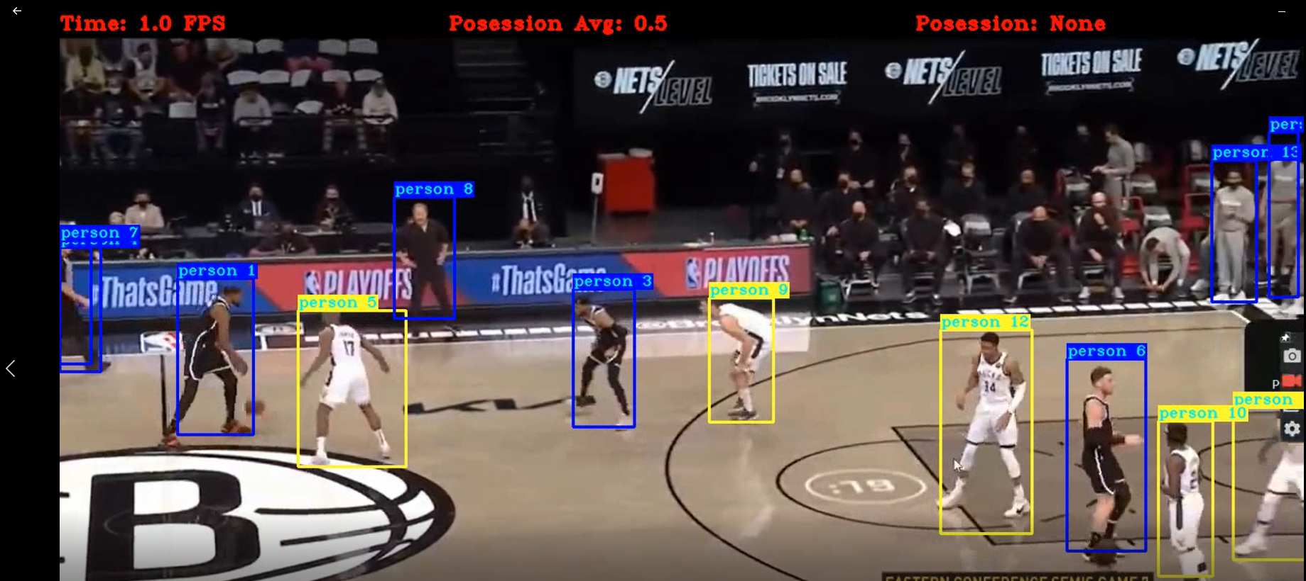

Slide 11




Team Identification
Apply “Masks” Using Computer Vision
Used OpenCV to return the ratio of white pixels to all pixels within a player's bounding box. These values were compared to the running average of the ratio to identify team.
Light Team – Ratio: 0.3
Dark Team – Ratio: .35

Slide 12
Team Possession
The program identifies when the ball is in the bounding box of a player to identify the player’s team.
These numbers are stored and averaged to determine which team has possession of the ball and this is displayed on the video.

Slide 13
Highlight Splicing
The program returns a list of “made basket” frames which can be used to splice together a “highlight reel”.

Slide 14
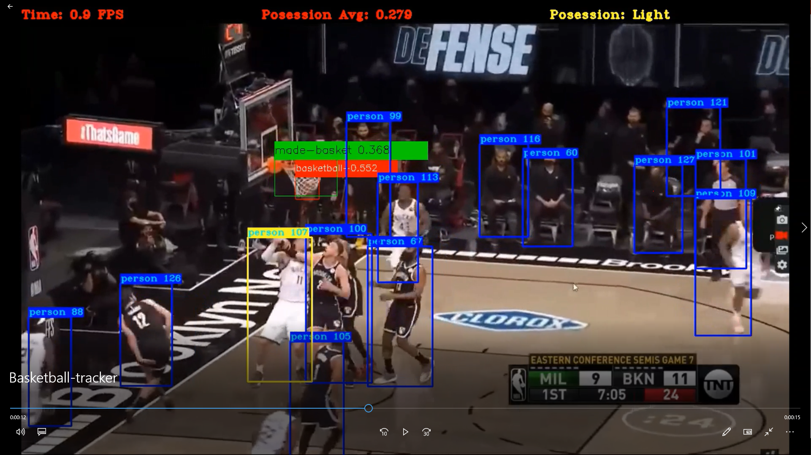
Putting it all Together

Slide 15
Conclusions
Model identified the basketball, made baskets, tracked players, identified teams, and tracked possession.
Used this information to log statistics and create a highlight reel.
Serves as a great proof of concept!

Slide 16
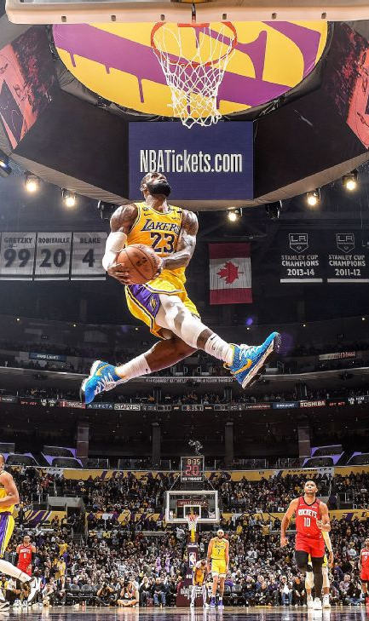
Next Steps
More Training on more data!
Utilize Jersey Numbers
Metrics
3pt vs 2pt vs Free Throws
Turnovers, Blocks, Rebounds

